Slide 1
Making the Connection
An Introduction to Non-Residential New Construction

Slide 2
Basic Questions for WSSC
Can I connect to water or sewer service?
How do I connect?
What are the costs?
If I have additional questions, where can I find answers?

Slide 3
Can I connect to water or sewer service?
Yes!
If…
there is adequate water and/or sewer service available adjacent to your property
and
the County has included your area in its 10-Year Water and Sewer Plan

Slide 4
How do I connect?
Find out if WSSC has pipes to connect to
Call WSSC Permit Services at (301) 206-4003
If pipes are available, apply for a ‘connection’
For small service connections (<3” water or <4” sewer): Applicant Built Connection Package
Master Plumber to construct
For larger service connections (>3” water or >4” sewer): Site Utility Process
Engineer to design
General Contractor to construct

Slide 5
How do I connect?
-OR-
If pipes are not available, build main extension
Phase 1: Hydraulic Planning Analysis (HPA)
planning of main extension alignment and sizing
Phase 2: System Extension Process (SEP) Design
detailed engineering design of extension in accordance with WSSC standards
Phase 3: System Extension Process (SEP) Construction
construction of the extension in accordance with WSSC specifications

Slide 6
What are the costs?
Plan design engineering & review costs
Construction costs
Permitting fees
Front Foot Benefit Charges
System Development Charges

Slide 7
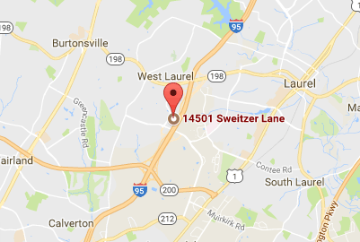
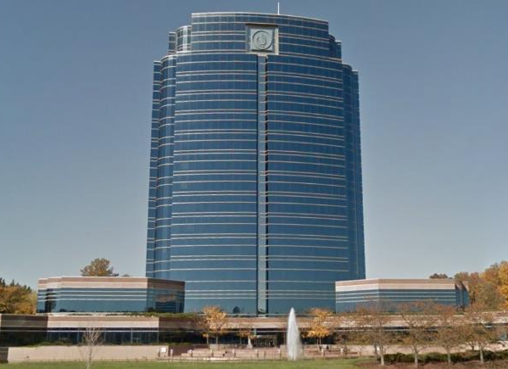
If I have additional questions, where can I find answers?
Contact Permit Services at (301) 206-4003
Visit the One Stop Shop at WSSC main building
14501 Sweitzer Lane, Laurel, MD 20707

Slide 8
If I have additional questions, where can I find answers?
Visit our website www.wsscwater.com
Business & Construction
Development/Construction Services

Slide 9
Common Site Utility Issues
Why can’t I just add another water service connection to provide sprinkler service to my building addition?
I need my building permits yesterday!
I did not anticipate needing an outside meter vault
Why am I paying all these additional plan review fees?

Slide 10
Helpful Hints
Hire qualified and experienced engineers, plumbers, contractors, etc.
Understand all the costs involved in your project
Don’t hesitate to call us or stop by!
Don’t forget we have an office in Rockville DPS Building

